Slide 1
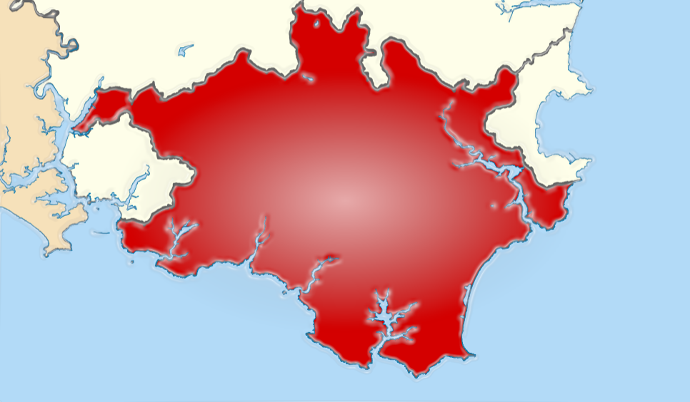
It’s ‘33 & things are great
How did we get here?

Slide 2
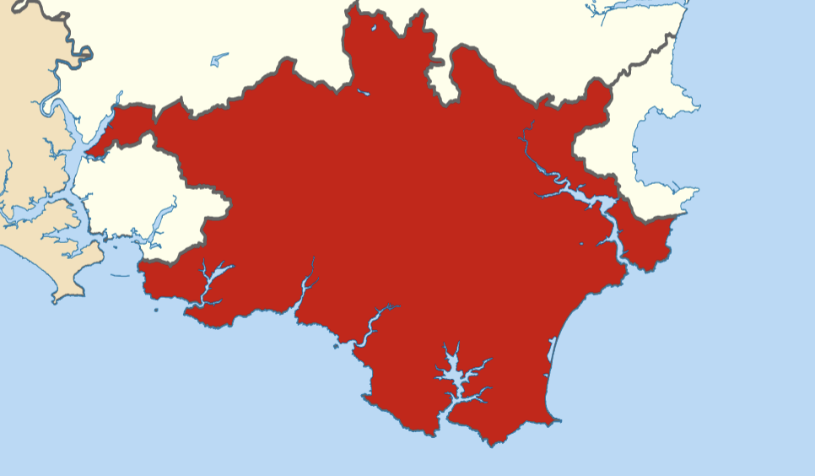
2023 was a time of change, and some good luck….
Farmers wanted change – SustainUK survey found 55% of farmers were ready to look at the market on their doorstep, much support for farmer owned co-operatives
Technology that can connect farmers to citizens was reliable, affordable and understandable
Local Authorities moved mountains to procure locally and support farmers of all sizes to achieve genuine agroecological transitions
Citizens finally saw for themselves the links between the food they ate and the climate & biodiversity crises
Retailers (ed’s note, we do not know which one went first), saw the need to differentiate themselves from the Supermarket blueprint that had established itself in the ‘80s, ie ride into town, run the local traders off the road and buy nothing from the locals. That changed…

Slide 3
And
A change of Government

Slide 4
In South Hams, after allowing for 2nd homes & holiday homes, there are approx. 44,000 households.
That spend an average of £4104 per year on food consumed at home & £1601 per year on take-outs and canteens.
In 2023, there were no figures, but it’s unlikely that more than a couple of percent of this spend was Organic & locally produced.
Which is a shame, as according to Sustain, the food charity, £1 spent on local food generates another £2.50 to circulate in the local economy.
While the same report said that around 25p is generated when that same £1 is spent in a supermarket.
And Organic Farming results in 50% more biodiversity than non-organic farming, and a lot more carbon is stored too.
So, we set the controls for 10% of the at home & out of home markets, and good things happened…..

Slide 5
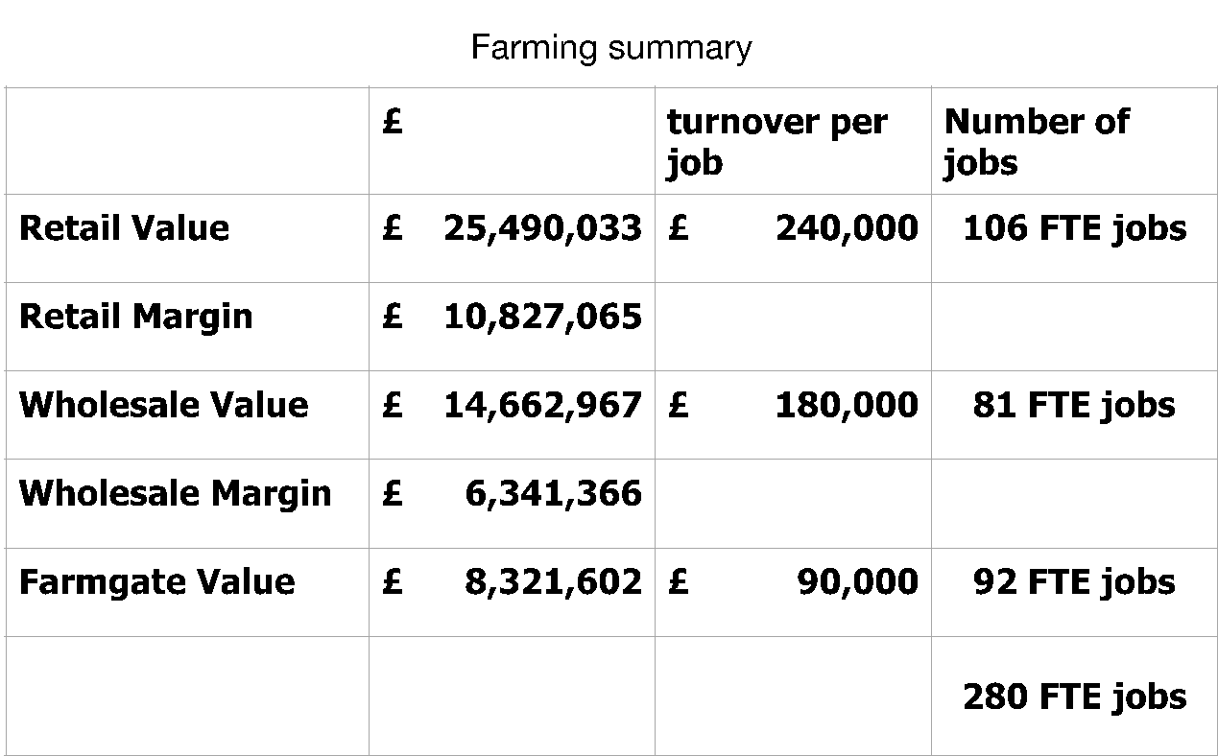
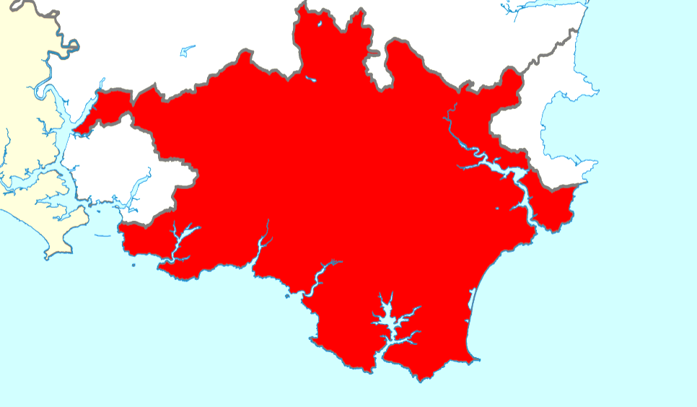

Slide 6
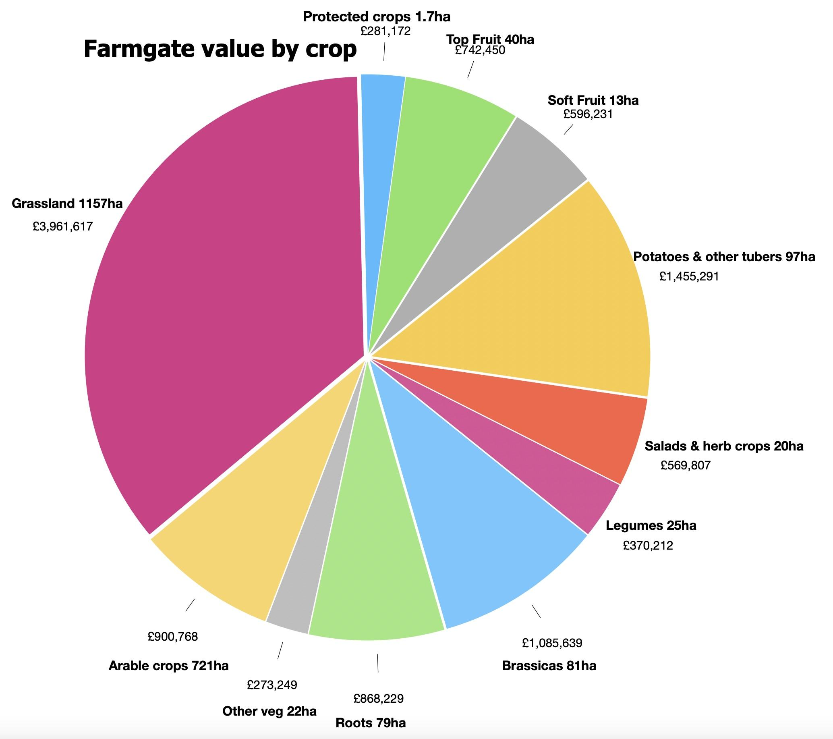
A 10% market share meant 1722ha of land converted to Organic methods
Resulting in Soil Organic Matter (SOM) rising from 5% up to 7.5% in the first 10 years
The 2.5% rise in SOM (of which 40% is Carbon) was about 120,000t of Carbon removed from the atmosphere across the 1722ha
Which is 2.7t of carbon for each of the 44,000 homes
The average UK citizen’s Carbon footprint is 2.7t of Carbon right now

Slide 7
Farmers
co-operate on growing, compete less, share IT & distribution
develop processing, freezing & packing
establish food hub(s) as part of a regional network
own their market, invest in it and engage with their citizen neighbours
Local Authorities
local procurement for schools, colleges & care homes, County farms given preferred access to LA procurement
sympathetic planning decisions for smaller units including worker & farmer accommodation, on farm processing, winter water storage for animals & irrigation
affirmative engagement with retailers to encourage & foster local sourcing across their stores & kitchens. Monitor and report the size & value of the local food economy

Slide 8
Thank You
Further Reading:
Devon’s Good Food Strategy from the Devon Food Partnership
Sustain UK + RSPB, “The Case for Local Food”
“Sitopia – How Food Can Save the World” by Carolyn Steel
Andy Johnson
hommedeterre@icloud.com

